Slide 1


GRAMMAR
LINKING VERBS
STANDARD FOUR DEPARTMENT

Slide 2

OBJECTIVES
Define linking verbs.
Differentiate between action verbs and linking verbs.
Identify linking verbs in sentences.
INSTRUCTIONS
Copy slides 4 and 5 into your notebooks.

Slide 3

Click on the link below to watch a short introductory video about linking verbs.
Linking Verbs | Award Winning Linking Verb Teaching Video | Parts of Speech | What is a Linking Verb - YouTube

Slide 4
Mary, Queen of Peace, pray for us.
Sacred Heart Girls’ R.C. School
Monday 18th October, 2021.
Grammar
Linking Verbs
Action verbs show action or movement for nouns, such as characters or objects. Most action verbs show action that can be seen. However, some action verbs such as think or understand cannot be seen.
Examples:
The bird flies over our house each morning.
She thinks she is the coolest child in her class.
However, linking verbs do not show action. Linking verbs connect who or what the sentence is about to other information in the sentence. In other words, linking verbs connect the subject of the sentence to the predicate without showing action.
Examples:
Judy is quite content with her grade.
He seems downcast because of the accident.
Some common linking verbs are: is, am, are, was, were, be, been, being, seem, become, feel, appear

Slide 5
Let’s practise!
Underline the verb in each sentence. Then, state whether the verb is a linking verb or an action verb. The first two sentences are done for you.
My dog’s fur smells bad all the time!
There are three children in the park today.
The clothes in that pile were extremely dirty.
Ria and I play Roblox on evenings.
Did you know that Jack’s computer is faster than his tablet?
The key to the secret tunnel broke in half.
Do you think that Mathematics became more difficult in Standard Four?
We rode our bikes through the park before the pandemic.
Sean checked the clock every few minutes.
The doorbell rang loudly.
That bookbag appears too heavy for you.
Those jeans are too small for me.
→ action verb
→ linking verb

Slide 6

CLASS DISCUSSION
Do you really understand linking verbs? Let’s see!
HELP THE TEACHER SOLVE THE FOLLOWING.
Last week, we looked at helping verbs.
What is the difference between a helping verb and a linking verb?
Can the words “was” and “am” both be helping verbs and linking verbs? Help!
A helping verb or an "auxiliary verb" is a verb that is used together with the main verb of the sentence to express the action.
Example: I am eating ice cream. – The verb phrased is “am eating”. The helping verb is “am”.
A linking verb is a verb that connects the subject with the rest of the sentence. The linking verb is not attached to any main verb.
Example: I am as cold as ice. – The linking verb is “am”.
SPECIAL NOTE ☺

Slide 7
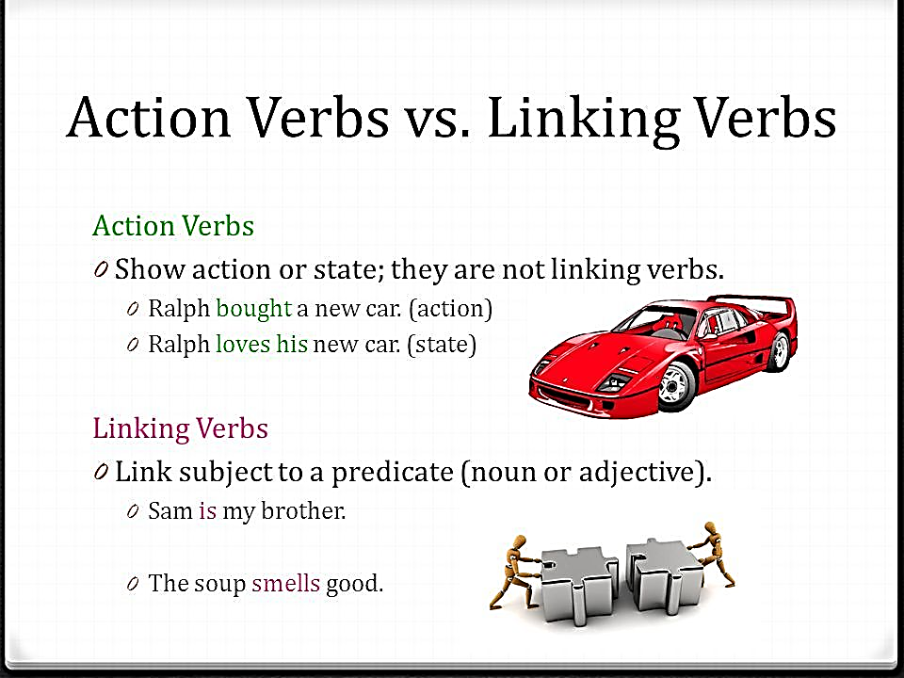
Let’s Recap!

Slide 8

REWARD TIME!
Click on the link below to play a game when you have completed your work!
Identifying Linking and Action Verbs | Verb Games | Turtle Diary

Slide 9

REFERENCES
linking verbs - Google Search
Linking Verbs | Award Winning Linking Verb Teaching Video | Parts of Speech | What is a Linking Verb – YouTube
Identifying Linking and Action Verbs | Verb Games | Turtle Diary

